Slide 1
DFC Master Protocol Schedule of Activities

Slide 2
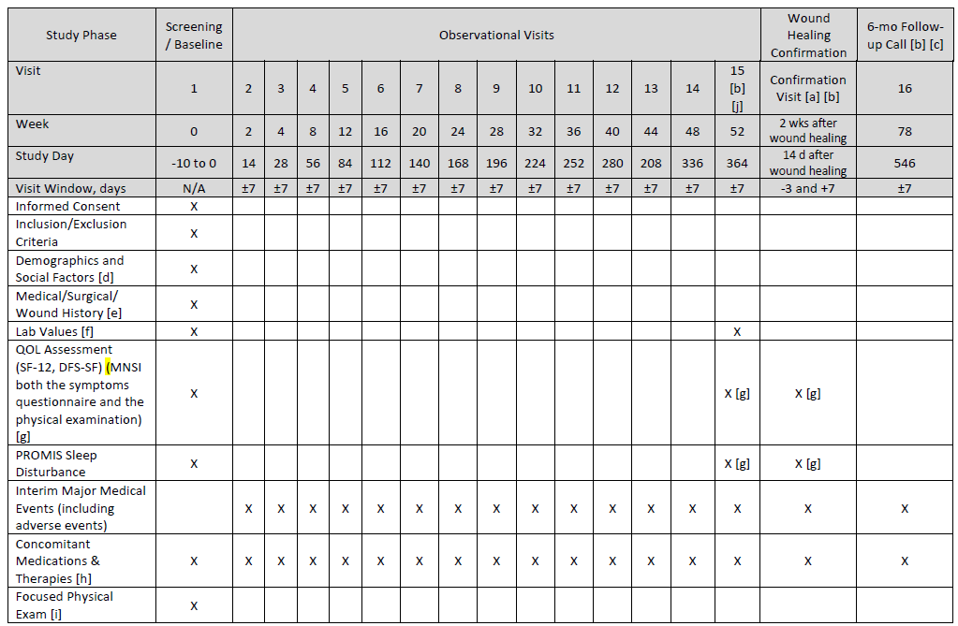

Slide 3
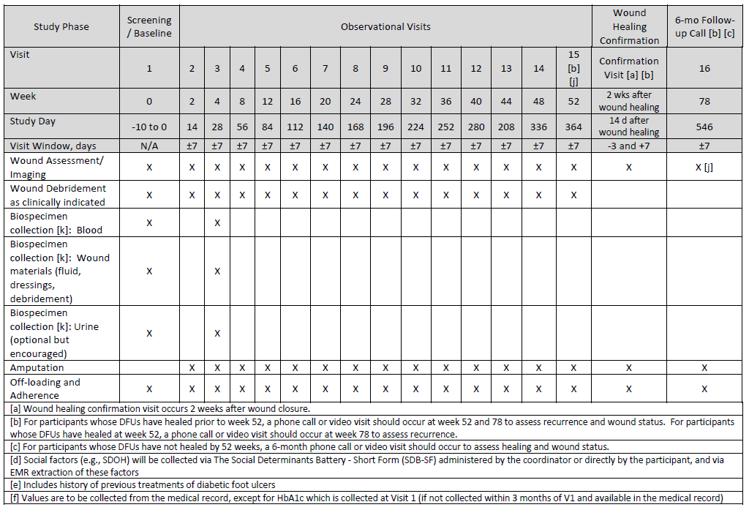
Notes:
BL wound assessment is included in subject level dataset and in the longitudinal dataset!

Slide 4
